Slide 1

CHEETAH ROBOT
Group no. 4

Slide 2

Presented by
Under the guidance of
K Charan 2018111
V. Vashruth 2018278
V. Subhash 2018276
Prof. V.K. Gupta
Dr. Prabin Kumar Padhy
Prof. Aparajita Ojha

Slide 3
DESIGN OBJECTIVE
As the title of our project suggests our robot resembles various operations performed by animals such as running, walking, crawling etc.
For the design of legs we have opted for a 4 link mechanism, we could have used 2 links by using a knee actuator but the design complexity is increased as it requires separate mechanism for transmission of power from motor to knee.
To get efficient result within the availability of motors we have restricted the size of robot to 23*9*9.

Slide 4
WORK PLAN
We have designed the replica of the original robot model that we decided to fabricate, in the modelling software SOLIDWORKS.
We have checked for difficulties that would result in adverse situation like resulting in an impposible configuration of the robot.
And we have decided to 3D print the leg links, servo holder and base that holds circuit and servos, as we have modeled them in solid works compatible to our model, and moreover other manufacturing process may result in human error.

Slide 5
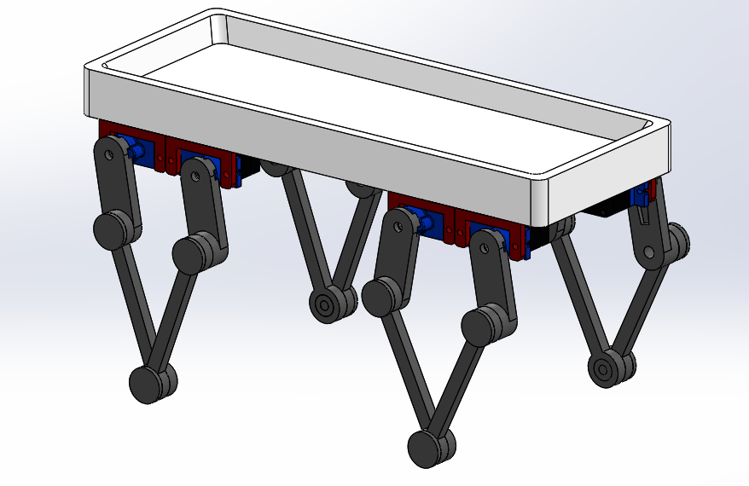
3D MODEL

Slide 6
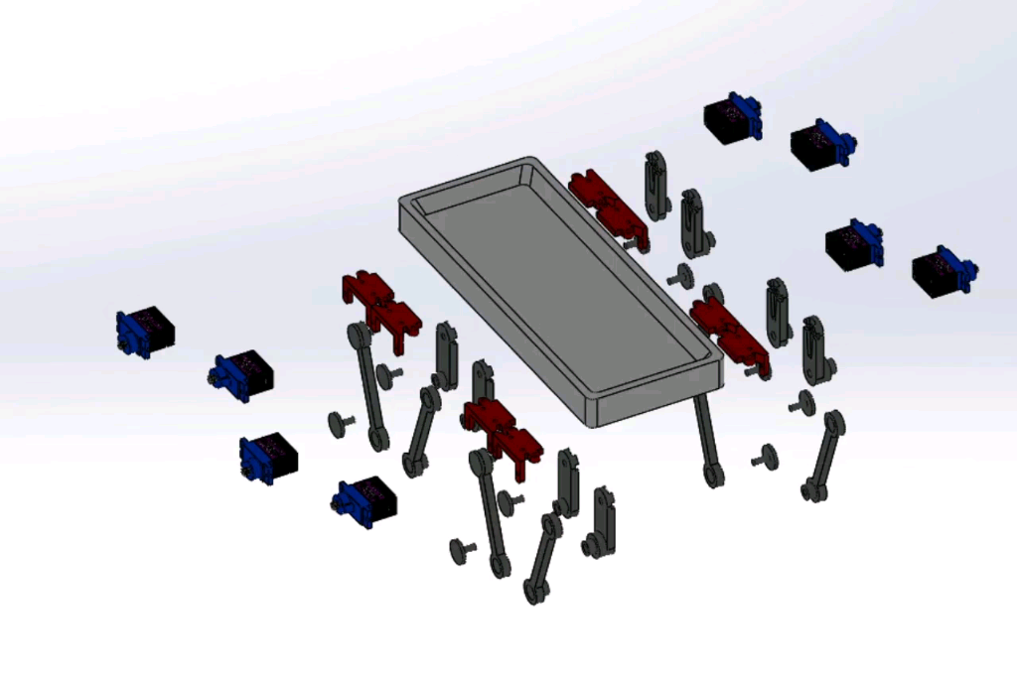
Exploded view of the Robot

Slide 7
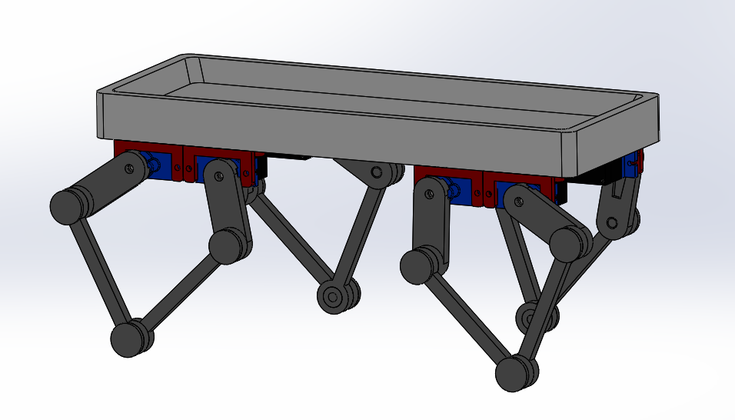
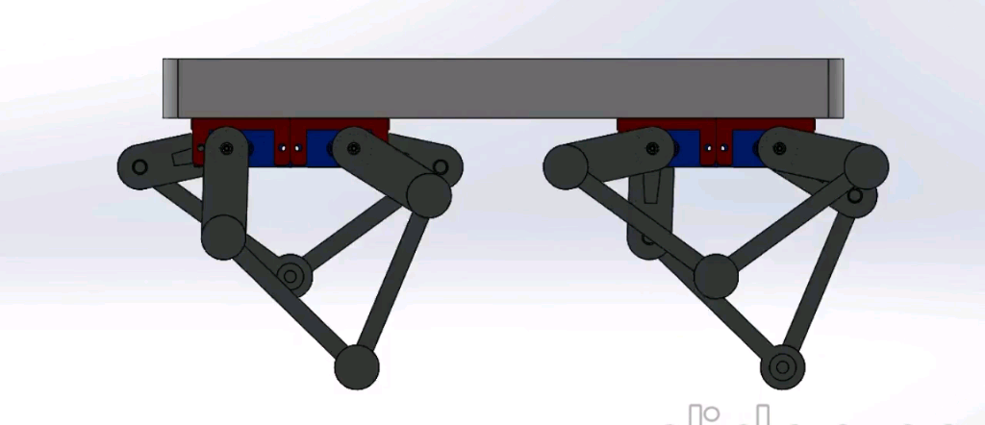
WHAT CAN THIS ROBOT DO
Forward and Backward walking

Slide 8
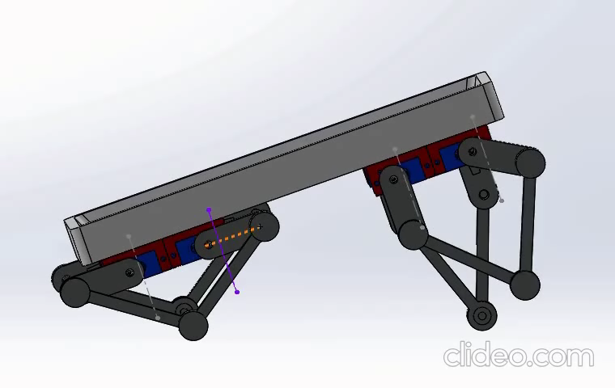
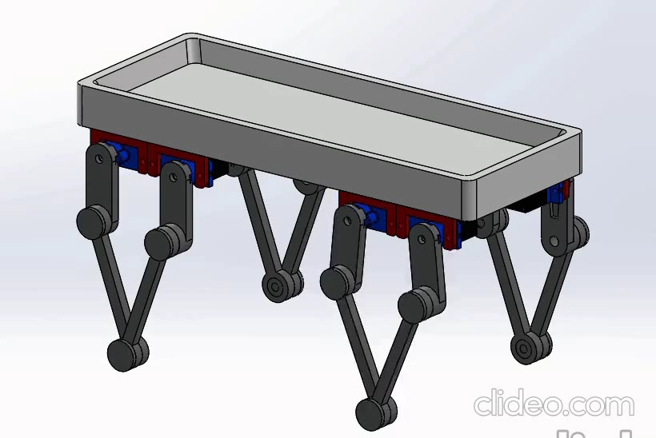
Saying Hi!
Self Checking

Slide 9
METHODOLOGY
This robot is equipped with 8 servo motors attached to the chassis frame, every leg has its individual movement and it is achieved with the help of 2 servo motors.
The initial positions of robot are defined in the Arduino code so that the servos accordingly position themselves wrt angles specified.
Likewise on receiving the specified command the servo positions itself accordingly to give motion to the robot.

Slide 10
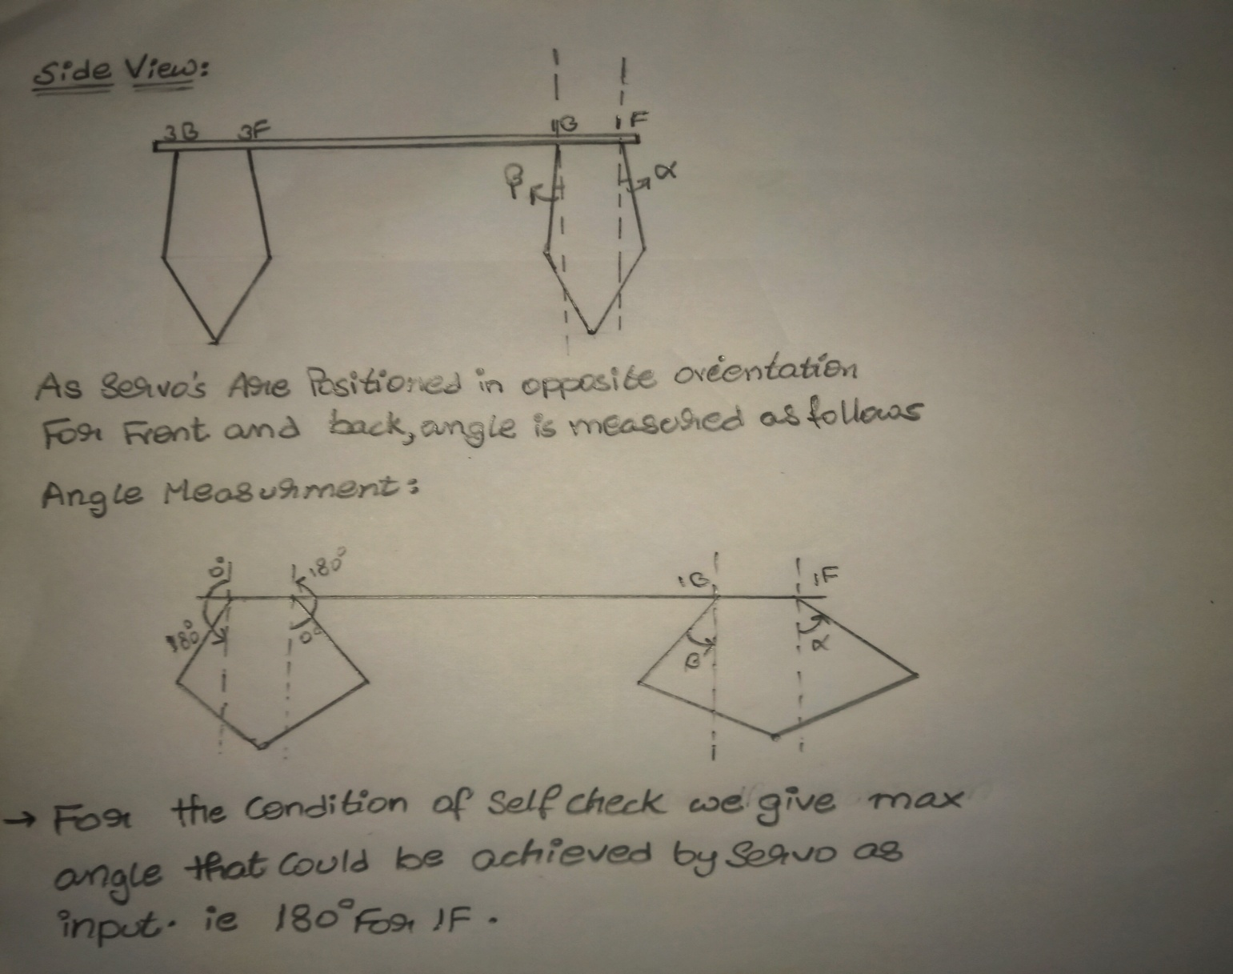

Slide 11
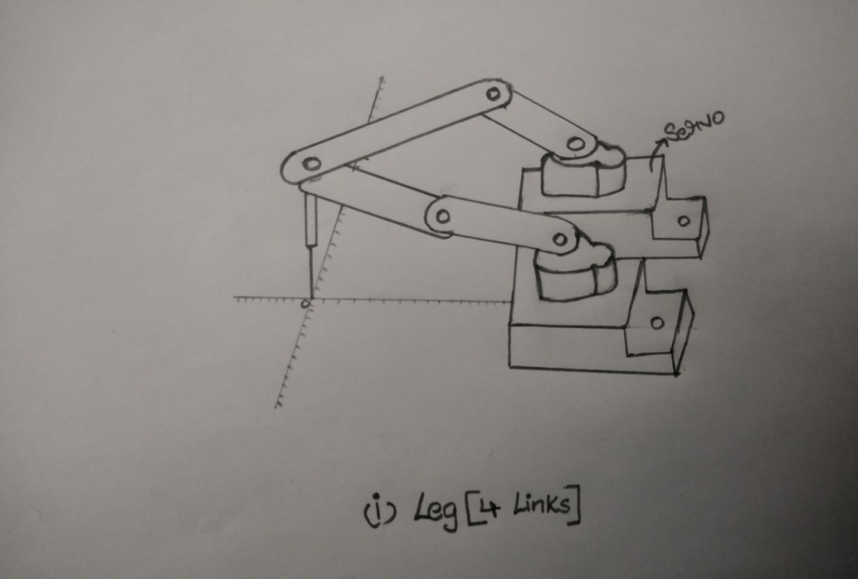
The Leg Trajectory Planning plays a crucial role in the proper functioning of the robot this could be achieved by various methods, we have thought of using a back tracking method where we compute the angles that were given to the servo .
We can achieve this by positioning the
legs on a graph paper and plot
the required path and compute the
rotation of the servo for the motion,
these angles are noted and given as
input for the servo.

Slide 12
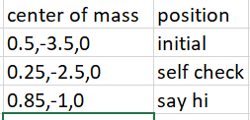
As we are not available with the servo motors and leg links we have made a choice of iterative method.
The sequence of angles that are given as input for the servo motors resulting the motion of robot in forward as well as backward direction are computed arbitrarily by an iterative method on paper and are verified in the solidworks and then we finalized the angles of servos while moving forward and backward.
We decided angles such that, the centre of mass of the robot doesn’t deviate more than 3mm, so that it will not loose it’s balance.

Slide 13
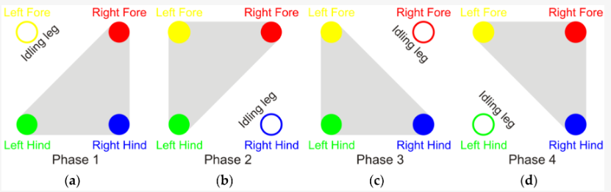
After designing the model we have checked whether the robot is statically stable or not for various configurations.
And after getting the projection of center of mass under the polygon defined by the other vertices we have proceeded further and this is verified in solid works (self check).
After getting valid support patterns by the feet under quadrupled walking we have added the corresponding angles into the Arduino code.
After obtaining center of mass within the polygon (grey area) the joint angles are fixed.

Slide 14
We have decided to use MG-90S servo motor which meets our requirments better.
Technical Specifications:
Operating Voltage: 4.8V to 6V (Typically 5V)
Stall Torque: 1.8 kg/cm (4.8V)
Max Stall Torque: 2.2 kg/cm (6V)
Operating speed is 0.1s/60° (4.8V)
Gear Type: Metal
Rotation : 0°-180°
Weight of motor : 13.4gm

Slide 15
Components Required
Arduino nano
HC-05 Bluetooth module
MG90S Servo
PCB board
SMPS
Technologies used to make virtual simulation
Proteus
Solid Works
Arduino IDE
MIT App Inventor 2

Slide 16
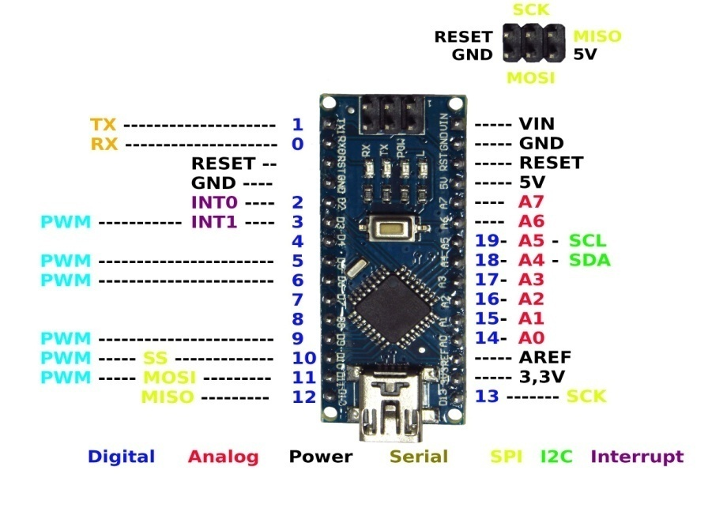
ARDUINO NANO
Arduino boards are widely used in robotics, embedded systems, and electronic projects where automation is an essential part of the system.

Slide 17
Arduino Nano is a small, compatible, flexible and breadboard friendly Microcontroller board,
developed by Arduino.cc, based on ATmega328p.
The microcontroller using in Nano board ATmega328 offers serial communication. This can be accessible at digital pins like TX, and RX.

Slide 18
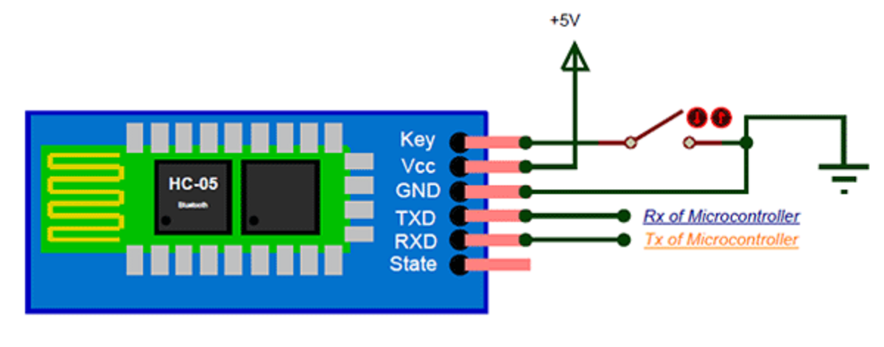
HC-05 ARDUINO BLUETOOTH MODULE
HC-05 is a Bluetooth device used for wireless communication with Bluetooth enabled devices like smartphone.It communicates with microcontrollers using serial communication (USART).

Slide 19
Pin | Description | Function
VCC | +5v | Connect to +5v
GND | Ground | Connect to Ground
TXD | UART_TXD, Bluetooth serial signal sending PIN | Connect with the MCU’s (Microcontroller and etc) RXD PIN.
RXD | UART_RXD, Bluetooth serial signal receiving PIN | Connect with the MCU’s (Microcontroller and etc) TXD PIN.
KEY | Mode switch input | If it is input low level or connect to the air, the module is at paired or communication mode. If it’s input high level, the module will enter to AT mode.

Slide 20
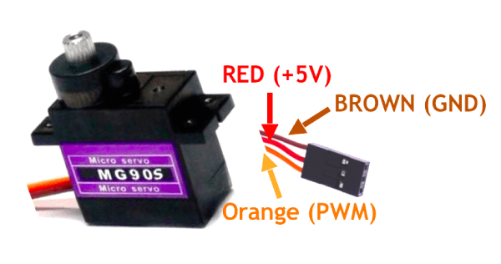
MG90S SERVO
The Servo Motor Micro MG90S is a micro size 180 degree analog servo with metal gears and strong construction.

Slide 21
The built-in cable has a 3-pin female connector that is usually mated with a male header.
Brown = Ground
Red = 5V
Orange = PWM

Slide 22
SWITCHED-MODE POWER SUPPLY(SMPS)
SMPS is an electronic power supply that incorporates a switching regulator to convert electrical power efficiently.
Like other power supplies, an SMPS transfers power from a DC or AC source (often mains power) to DC loads, such as a personal computer, while converting voltage and current characteristics.

Slide 23
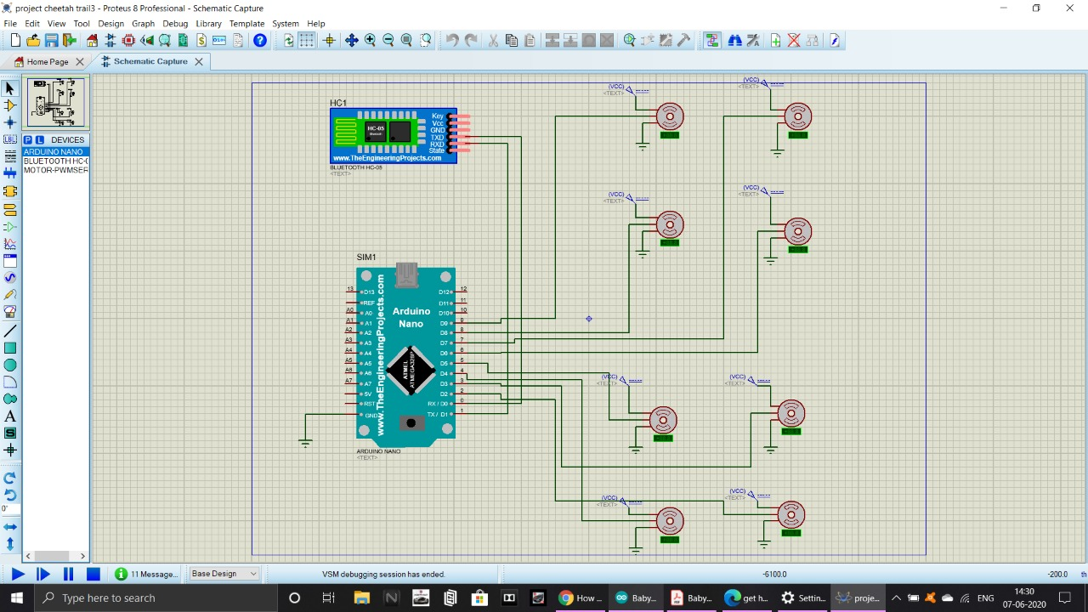
SIMULATION

Slide 24
CONNECTIONS
TXD(Bluetooth) – RX(Arduino)
RXD(Bluetooth) – TX(Arduino)
2 to 9 digital pin(Arduino) – Signal pins of 8 servo motors
5V SMPS – Vcc pin of 8 servo motors
12 =V SMPS – Vin pin(Arduino)
GRND SMPS – Ground of Arduino and 8 servo motors
Click here for Proteus simulation

Slide 25
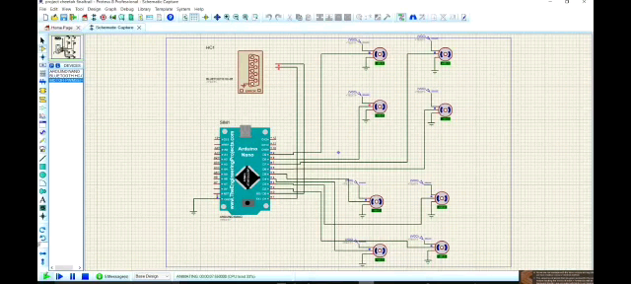
PROTEUS SIMULATION

Slide 26
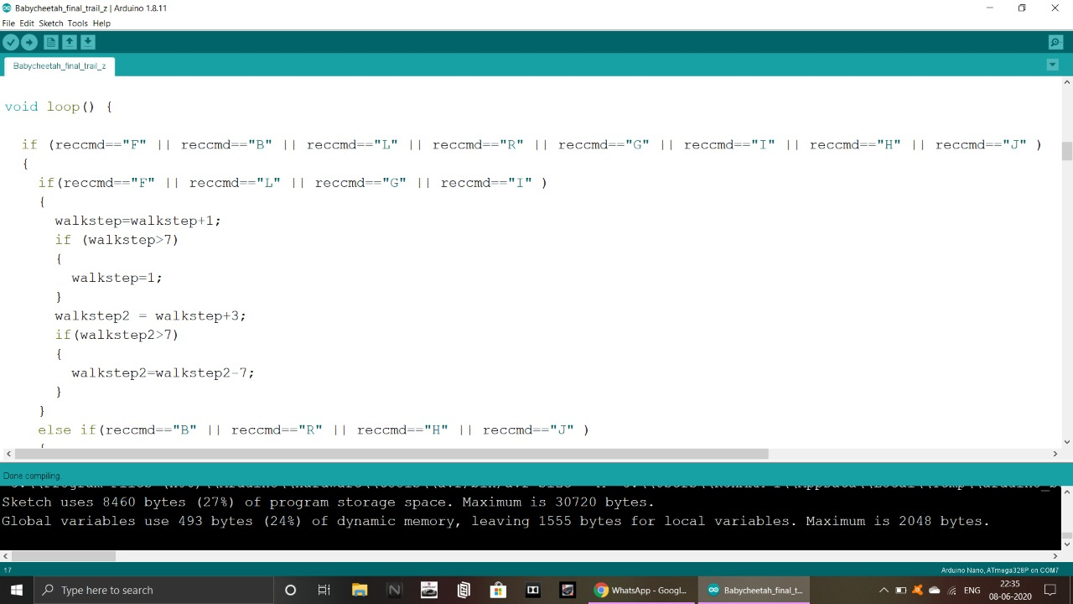
ARDUINO CODE
Click here for Arduino code

Slide 27
Designing of mobile App
A mobile app was designed by us to control the Cheetah actions
G -> Move front with left turn F -> Moves front I -> Move front with right turn L -> Turn left in same place S -> Stop R -> Turn Right in same place. H -> Move back with left turn B -> Move back J -> Move back with right turn U -> One step up on all legs | D -> One step down on all legs W -> Front two legs down by a step X -> Back two legs down by a step Y -> Front two legs up by a step Z -> Back two legs up by a step O -> Full stand from any position P -> Full sit from any position C -> Self checking of all legs V -> Sit and wave one leg

Slide 28
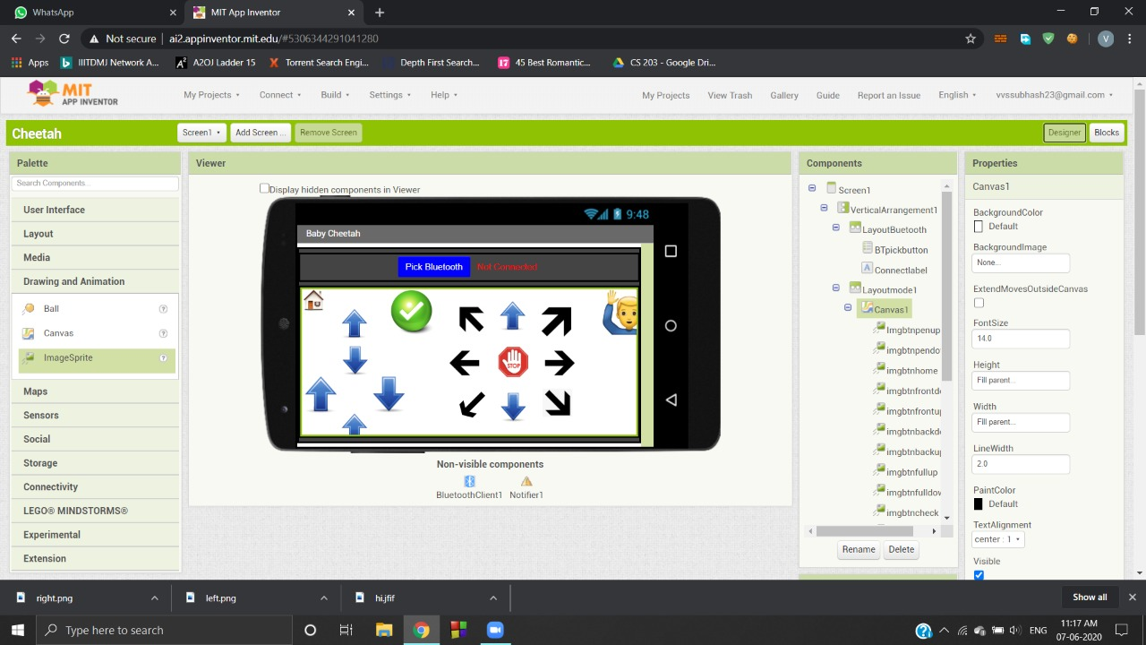
Designing of Mobile app
To perform the desired functions by the cheetah robot, we have designed a mobile application using MIT App inventor. The application connects to the robot’s arduino using a HC-05 bluetooth module.

Slide 29

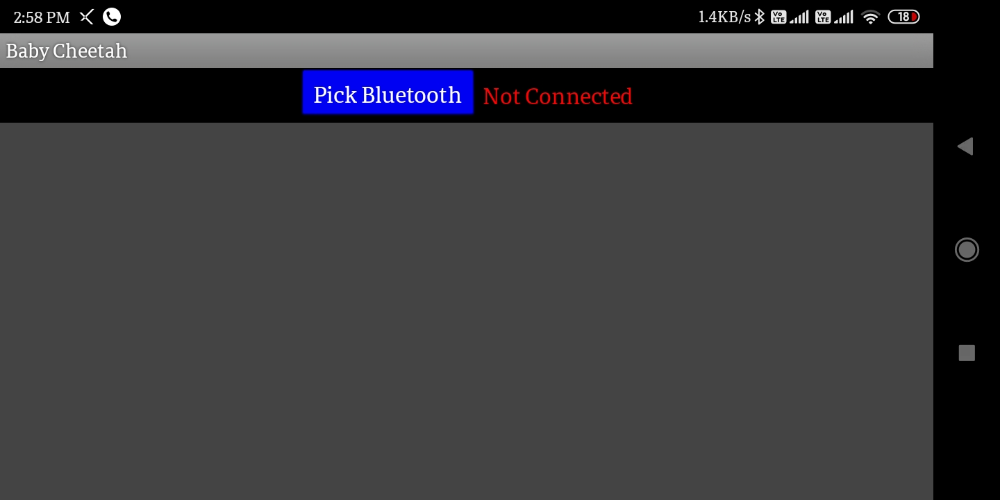
Snap shots from mobile app

Slide 30
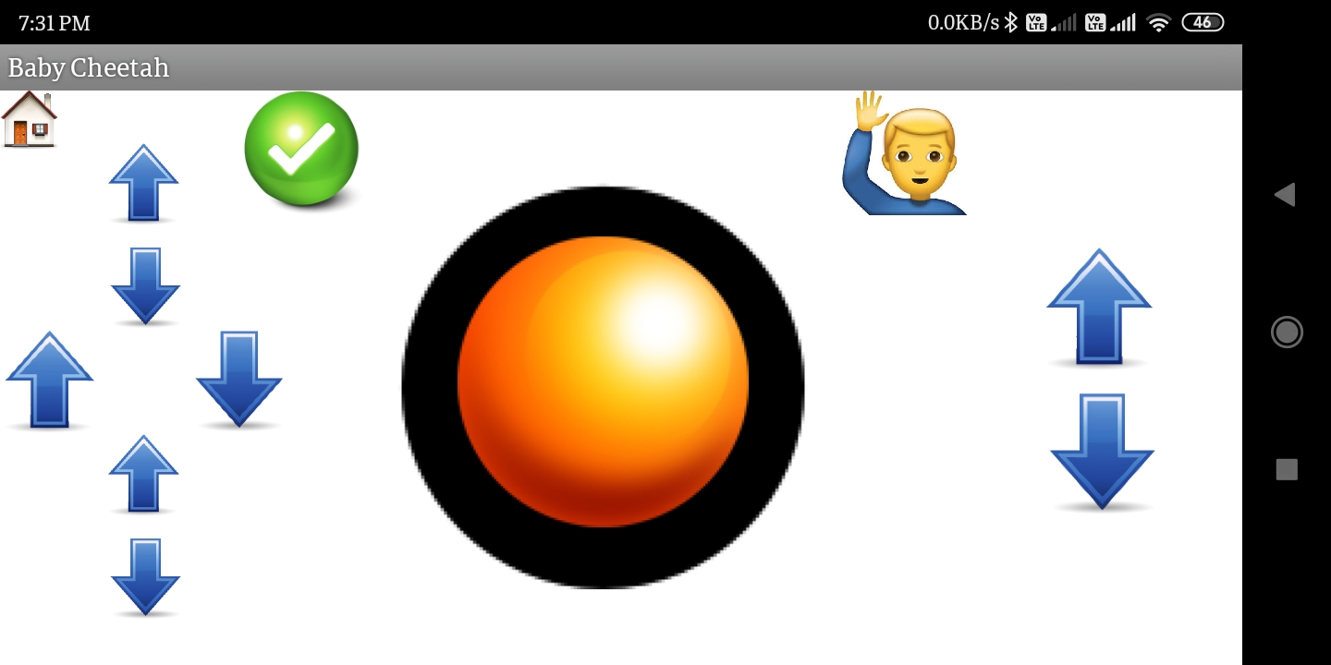
Controller description
Self Check
Front legs one step up
Say Hi..
Front legs one step down
Joy Stick to control
One step up
Front, Back
Left, Right
Front-right
Front-left
Back-right
Back-left
Stands up
Sit Down
One step down
Back legs one step up
back legs one step down

Slide 31
WORK PLAN
We have designed the replica of the original robot model that we decided to fabricate, in the modelling software SOLIDWORKS.
We have checked for difficulties that would result in adverse situation like resulting in an impposible configuration of the robot.
And we have decided to 3D print the leg links, servo holder and base that holds circuit and servos, as we have modeled them in solid works compatible to our model, and moreover other manufacturing process may result in human error.

Slide 32
FUTURE MODIFICATIONS
Using 2 links instead of 4 for each leg by attaching a belt or chain transmission from the motor to the knee .
Adding gyroscope sensor and ultrasonic sensor to the Arduino and try to make it an autonomous robot.
And robot could be upgraded by equipping it with 2 extra servo motors providing side wise movement without a turn by attaching them to the middle of crossection.

Slide 33
DESIGN INSPIRATION
One of the motivation behind this project is the cheetah made by MIT.
Ghost Robotics is also one of the inspiration behind the project.

